Slide 1
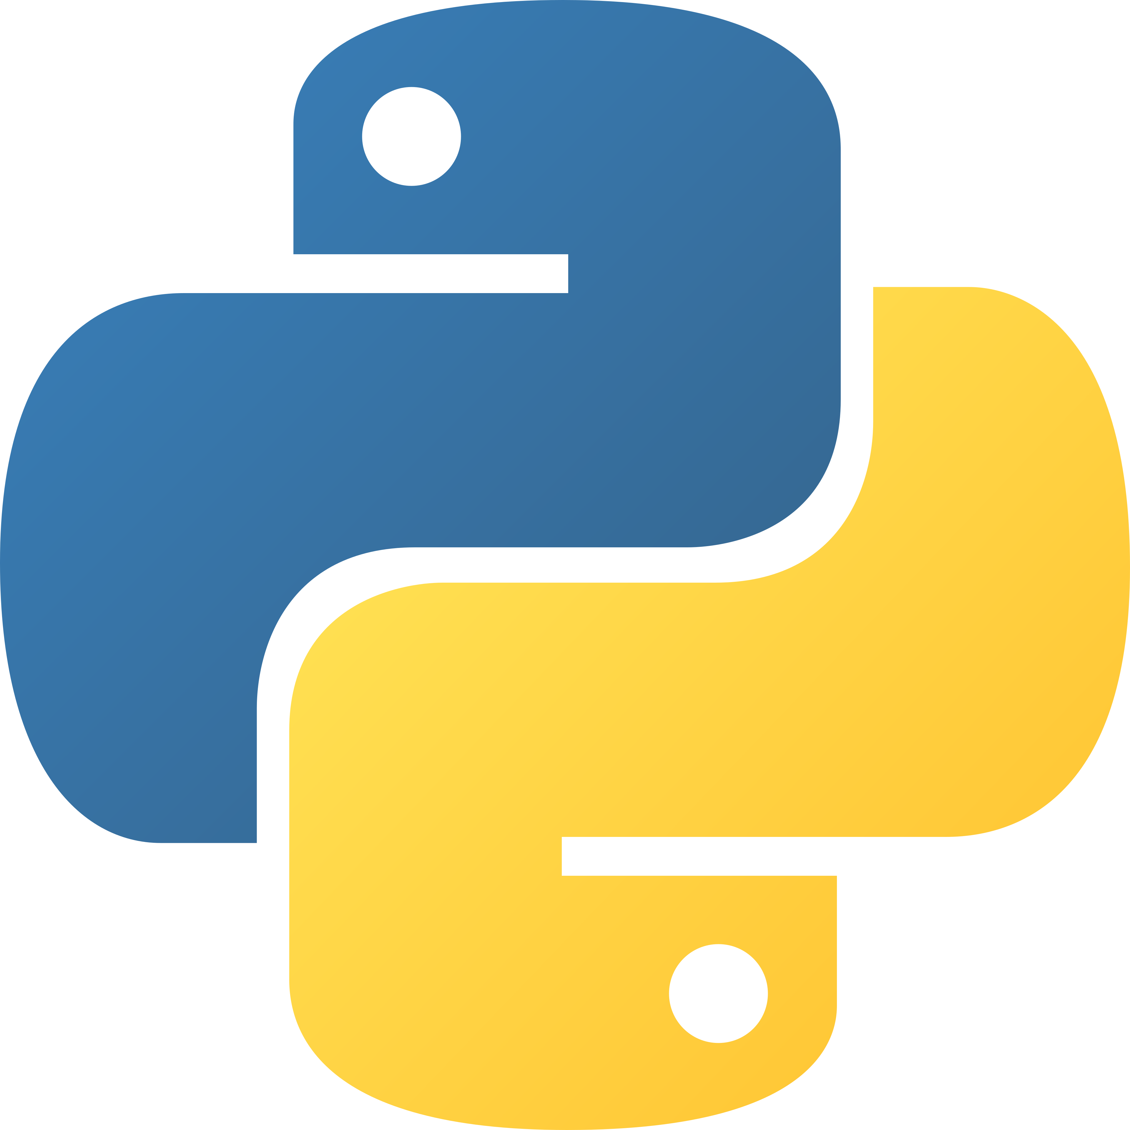
Introduction to Python
# my first program
print("Hello World")
# Hello World
PYTHON FOR BEGINNERS · DAY 1
Your first steps in programming
Instructor: Homaira Mohammadi
Notes:
Welcome to Introduction to Python! By the end of today, everyone will have written and run their first Python programs.

Slide 2

By the end of today, you can…
SESSION GOALS
Explain what Python is
Say where Python is used
Install and run Python
Write your first programs
Use print() statements
Add comments in Python
Follow basic syntax rules
Solve a simple challenge
Python for Beginners · Day 1: introduction
2
Notes:
Read the goals together. Reassure students: no experience is needed.

Slide 3

Clear, step-by-step instructions
WHAT IS PROGRAMMING?
💧
☕
🥛
🍽️
1. Heat water
2. Add coffee
3. Add milk
4. Serve
A coffee machine needs every step, in the right order. Computers are the same: they do exactly what we tell them.
Python for Beginners · Day 1: introduction
3
Notes:
Ask: what happens if we serve before heating the water? The order matters. Programming is giving a computer precise steps in a language it understands.

Slide 4
A language that’s easy to read
WHAT IS PYTHON?
Key facts
Why it’s popular
A high-level language (close to English)
Simple syntax
Created by Guido van Rossum in 1991
A large, friendly community
Easy to read and write
Many free libraries (ready-made tools)
Used by beginners and professionals
Used in AI and data science
Python for Beginners · Day 1: introduction
4
Notes:
Fun fact: Python is named after the comedy group Monty Python, not the snake!

Slide 5
Almost everywhere!
WHERE IS PYTHON USED?
🤖
📊
🌐
⚙️
🔐
AI
Data
Web
Automation
Security
Chatbots, machine learning, computer vision
Data analysis and charts
Websites and APIs
Files and repetitive tasks
Security tools and network analysis
Python for Beginners · Day 1: introduction
5
Notes:
Ask students which area interests them most. This keeps them motivated through the basics.

Slide 6
Easy to learn, quick to build
PYTHON VS OTHER LANGUAGES
Language | Difficulty | Common use
Python | Easy | AI, data, automation
Java | Medium | Applications
C | Hard | Systems
JavaScript | Medium | Web
Python is not the fastest language, but it lets you solve problems quickly.
Python for Beginners · Day 1: introduction
6
Notes:
All languages share the same ideas: variables, decisions, loops. Once you learn Python, other languages become much easier.

Slide 7
Pick one way to write code
SETTING UP PYTHON
⭐ EASIEST
ON YOUR COMPUTER
VERY SIMPLE
Google Colab
VS Code
Python IDLE
Runs in your browser. Nothing to install — just a Google account.
Install Python, then the Python and Jupyter extensions.
Comes with Python from python.org.
Python for Beginners · Day 1: introduction
7
Notes:
For the first class, have everyone open Google Colab so nobody gets stuck on installation. The step-by-step setup guide is in resources/setup-guide.md on GitHub.

Slide 8
Hello World
YOUR FIRST PROGRAM 🎉
Code
Output
print("Hello World")
Hello World
print() is a function: a built-in command that shows information on the screen. Whatever is inside the brackets is shown.
Python for Beginners · Day 1: introduction
8
Notes:
Everyone types this and runs it with Shift + Enter. Celebrate: you are now a programmer!

Slide 9
How Python runs your code
BEHIND THE SCENES
1
2
3
4
5
Write
Read
Compile
Execute
Output
You type code in an editor
The interpreter checks for mistakes
Code becomes bytecode
The Python Virtual Machine runs it
You see the result: Hello World
Python reads your code from top to bottom and stops if it finds a mistake.
Python for Beginners · Day 1: introduction
9
Notes:
Students don't need to remember every step. The key idea: Python reads line by line, top to bottom.

Slide 10
Text needs quotes, numbers don’t
UNDERSTANDING PRINT()
Code
Output
print("Welcome to Python")
print("My name is Homaira")
print(2026)
print("I am", 20, "years old")
Welcome to Python
My name is Homaira
2026
I am 20 years old
Use commas to print several things on one line — Python adds the spaces.
Python for Beginners · Day 1: introduction
10
Notes:
Text is called a string and needs quotes (single or double). Numbers don't. Each print() starts a new line.

Slide 11
Python is a calculator
PRINTING CALCULATIONS
Code
Output
print(5 + 3)
print(10 * 2)
print(20 / 4)
print("5 + 3")
8
20
5.0
5 + 3
/ always gives a decimal: 5.0
With quotes it’s text, not maths
Python for Beginners · Day 1: introduction
11
Notes:
Ask the class to predict each line before running. The last line surprises many: quotes turn it into text, so Python prints it exactly as written.

Slide 12
Notes for humans
COMMENTS
# This program prints my name
print("Ali")
# print("switched off")
A comment starts with #
Python ignores it
Explain what your code does and why
Tip: put # in front of a line to switch it off
Python for Beginners · Day 1: introduction
12
Notes:
Comments help your teacher, your classmates, and you next week. Good programmers write comments.

Slide 13
Two rules to remember
SYNTAX = GRAMMAR RULES
Rule 1 · Case-sensitive
Rule 2 · Indentation
Capital and small letters are different.
Spaces at the start of a line group code.
name ≠ Name ≠ NAME
print ✅ Print ❌
if True:
print("Hello")
Python for Beginners · Day 1: introduction
13
Notes:
Indentation is a sneak peek: students will use it a lot from Day 3 with if statements.

Slide 14
Common beginner errors
🐛 ERRORS ARE NORMAL!
Wrong capital
Missing quotes
Unclosed quote
❌ Print("Hello")
✅ print("Hello")
❌ print(Hello)
✅ print("Hello")
❌ print("Hello)
✅ print("Hello")
Read the last line of the error message, then check spelling, capitals, quotes and brackets.
Python for Beginners · Day 1: introduction
14
Notes:
Run each broken line live so students see real error messages: NameError, NameError, SyntaxError. Every programmer sees errors every day; the skill is reading them.

Slide 15
Program 1: introduce yourself
💻 LIVE CODING · 15 MINUTES
print("My name is Ahmed")
print("I am studying Computer Science")
print("I want to become a programmer")
Change the text to your own details.
Add at least 4 lines and one comment.
Run it with Shift + Enter.
Python for Beginners · Day 1: introduction
15
Notes:
Walk around and help. Ask a few volunteers to share their program on the screen.

Slide 16
What is the output?
🧠 MINI PRACTICE
Question 1
Question 2
Question 3
print("Python")
print("Programming")
print(10+5)
print("A")
# print("B")
print("C")
Python for Beginners · Day 1: introduction
16
Notes:
Answers: Q1 = Python and Programming on two lines. Q2 = 15. Q3 = A and C (B is a comment, so Python ignores it).

Slide 17
Well done on Day 1!
⭐ Hello, my name is…
🏆 END OF CLASS CHALLENGE
⭐⭐ Fix the bugs 🐛
⭐⭐⭐ Business card 🪪
Create your own program using print(), then try exercises.ipynb in the Day 1 folder.
Next lesson: Variables & data types 📦
Notes:
Congratulate everyone on their first day of programming. The challenge can be homework.

